Slide 1

Strain Imaging of Carotid Plaque
Matthew M. McCormick
matt@mmmccormick.com
Ultrasound Research Group
Department of Biomedical Engineering
Department of Medical Physics
University of Wisconsin-Madison
Presentation for Kitware, Inc.
April 26, 2011

Slide 2
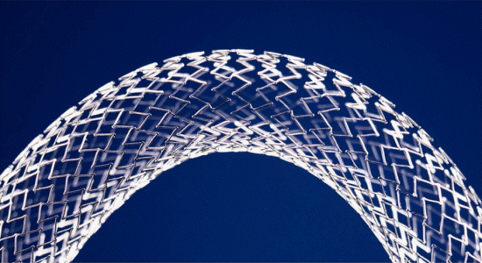



Biomedical Engineering
Stent image source: http://www.phiengineering.com/nitinol.htm

Slide 3
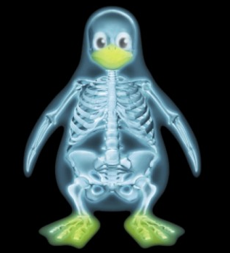

Biomedical Engineering

Slide 4
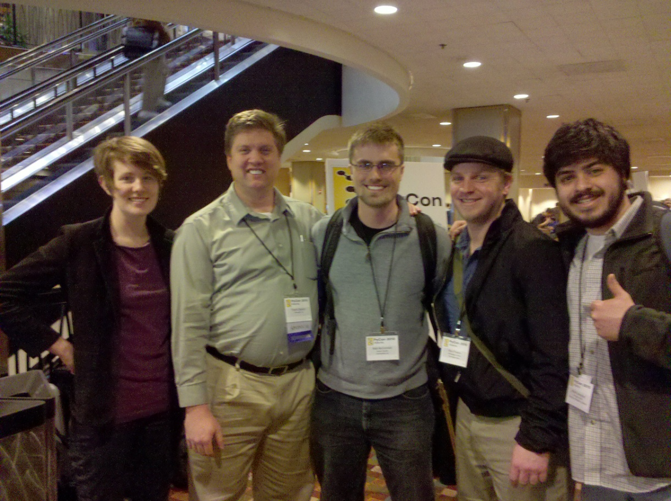

FLOSS
hackerwithin.org

Slide 5
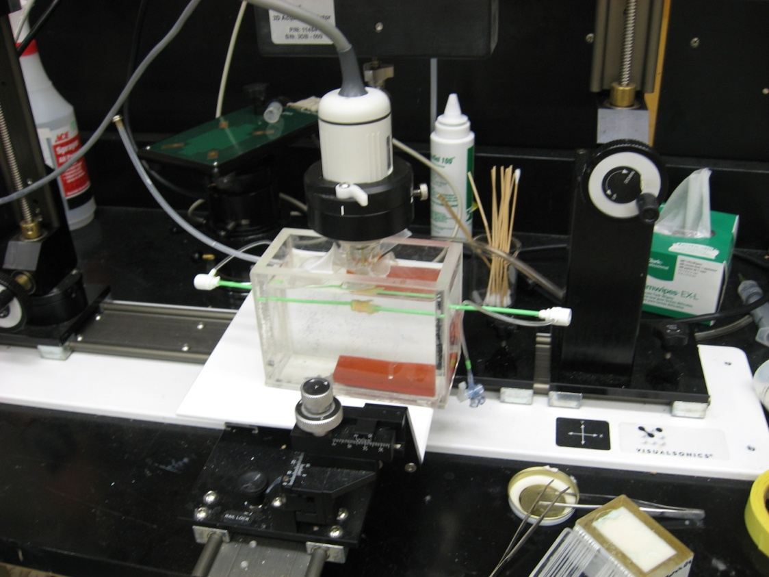
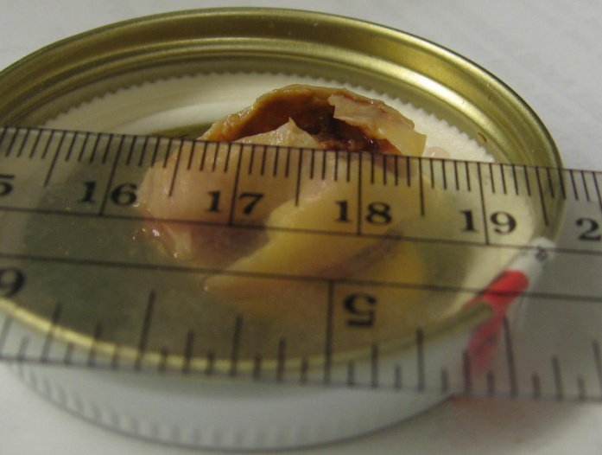
Kitware

Slide 6
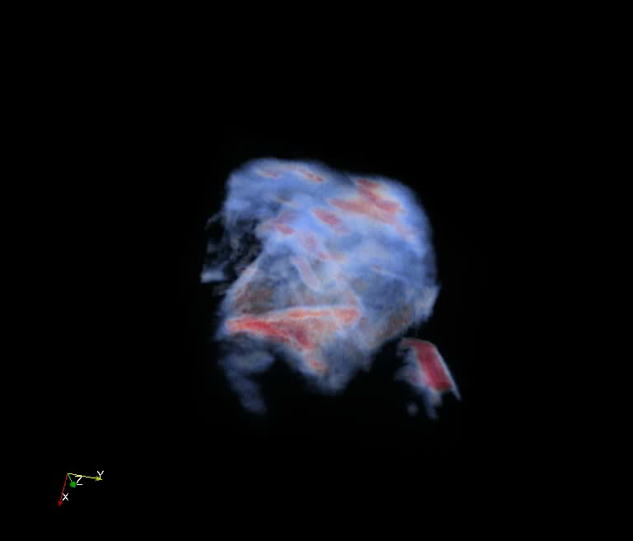

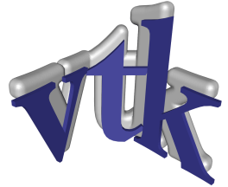
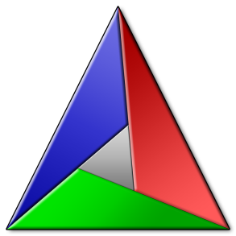



Kitware

Slide 7
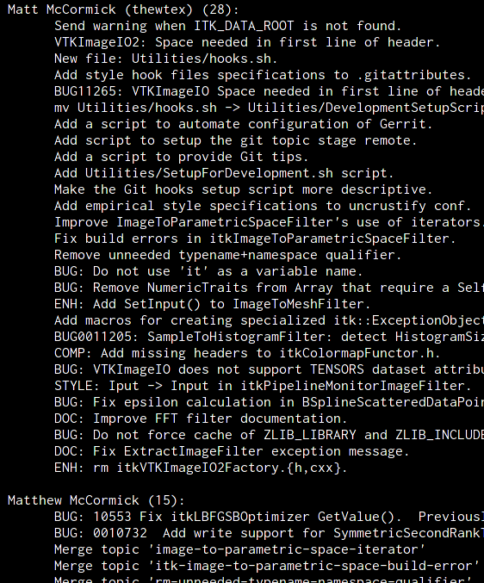
Kitware
./Utilities/SetupForDevelopment.sh

Slide 8
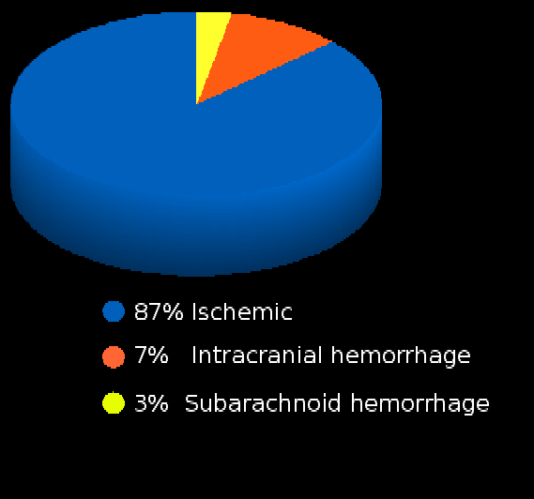
Etiology of Stroke
Stroke can be caused by subarachnoid hemorrhage or intracranial hemorrhage, but ischemic stroke is the most common.
¹American Heart Association. Heart disease and stroke statistics – 2008 update. Online.

Slide 9
Etiology of Stroke
Ischemic stroke can occur through a hemodynamic, thrombotic, or embolic mechanism.
¹American Heart Association. Heart disease and stroke statistics – 2008 update. Online.

Slide 10
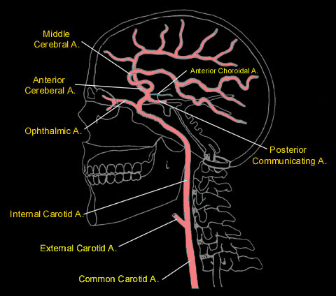
Etiology of Stroke
Emboli have many origins.
Atrial fibrillation
Congestive heart failure
Mechanical heart valve
Patent foramen ovale
Plaque fragments or thrombi originating from the carotid artery
Image source: http://www.meddean.luc.edu/lumen/MedEd/neuro/neurovasc/navigation/ica.htm

Slide 11
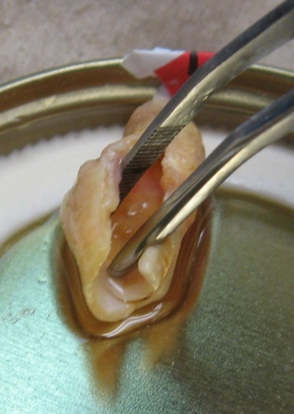
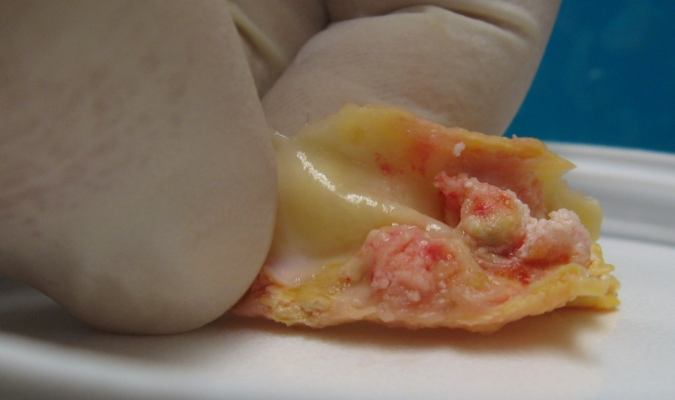
Differentiating high risk carotid plaques
Although many people will accumulate plaque, only a few will develop ischemic symptoms.

Slide 12
Differentiating high risk carotid plaques
The purpose of this research:
Development of a method to identify and differentiate high risk plaque.

Slide 13
Factors that increase risk
Increased hemodynamic forces
Hypertension
Cyclic loading
Stress concentrators
Material inhomogeneity
Morphological irregularity
Ulceration
Vasa vasorum
Weak materials
Inflammation and enzymes such as matrix metalloproteinase-9.
Weak constituents such as lipid or fresh hemorrhage.

Slide 14
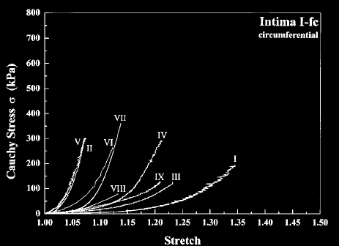
Proposed method for assessing risk
Image plaque strain.
Quantifies local compression and stretching experienced by tissue.
Figure taken from G.A. Holzapel, G. Sommer, and P. Regitnig. Anisotropic mechanical properties of tissue components in human atherosclerotic plaques. Journal of Biomechanical Engineering – Transactions of the ASME. 126(5):657-665, 2004.

Slide 15
Strain imaging algorithm Overview
Displacement Images
Strain Images
Cardiac Cycle Accumulation
Strain Metrics
Notes:
15

Slide 16
Strain imaging algorithm Block-matching motion tracking
Deformable image registration
Does not fit in ITK framework
ITK block-matching framework consisting of 30 classes
Displacement Images
Strain Images
Cardiac Cycle Accumulation
Strain Metrics
Notes:
16

Slide 17
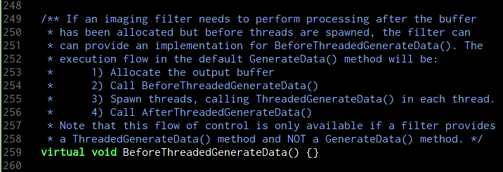
Strain imaging algorithm ITK Multithreading
Displacement Images
Strain Images
Cardiac Cycle Accumulation
Strain Metrics
Notes:
17

Slide 18
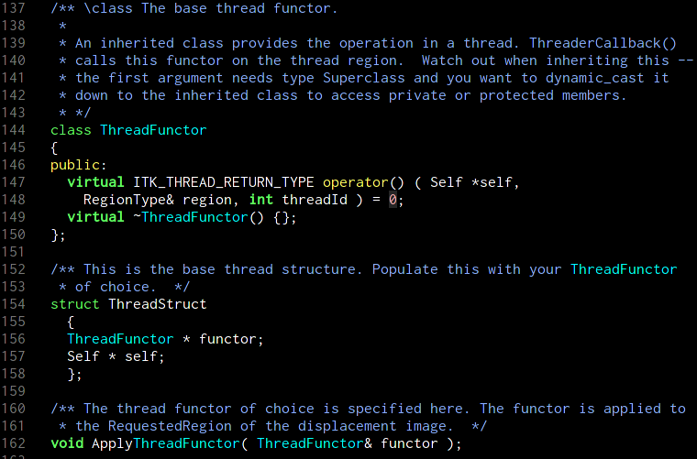
Strain imaging algorithm ITK Multithreading
Displacement Images
Strain Images
Cardiac Cycle Accumulation
Strain Metrics
Notes:
18

Slide 19
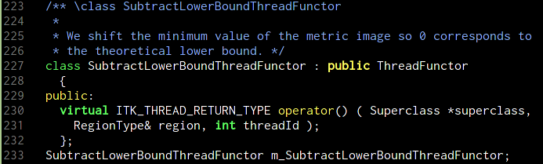
Strain imaging algorithm ITK Multithreading
Displacement Images
Strain Images
Cardiac Cycle Accumulation
Strain Metrics
Notes:
19

Slide 20
Strain imaging algorithm ITK Multithreading
Displacement Images
Strain Images
Cardiac Cycle Accumulation
Strain Metrics
Notes:
20

Slide 21
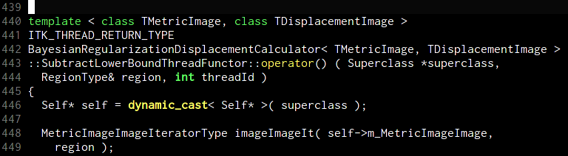
Strain imaging algorithm ITK Multithreading
Displacement Images
Strain Images
Cardiac Cycle Accumulation
Strain Metrics
Notes:
21

Slide 22
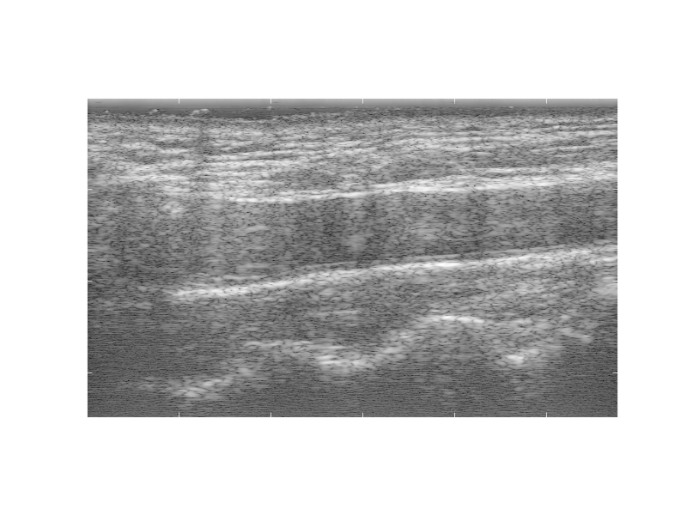
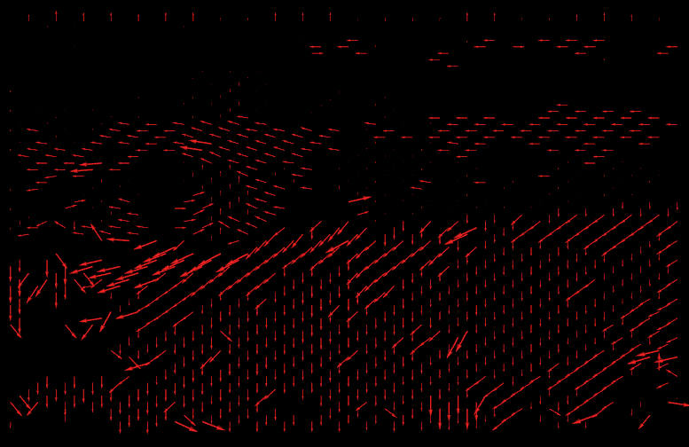

Strain imaging algorithmm Block-matching motion tracking
Fixed
image
Displacement field
Displacement Images
Moving
image
Strain Images
Cardiac Cycle Accumulation
Strain Metrics
Notes:
22

Slide 23
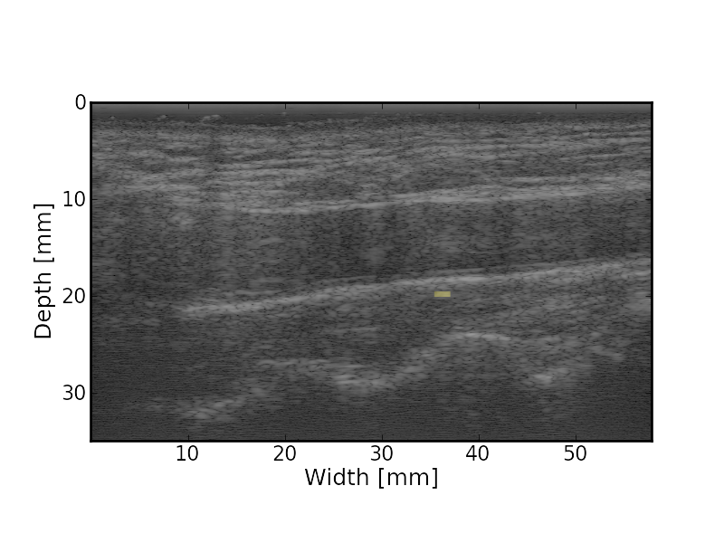
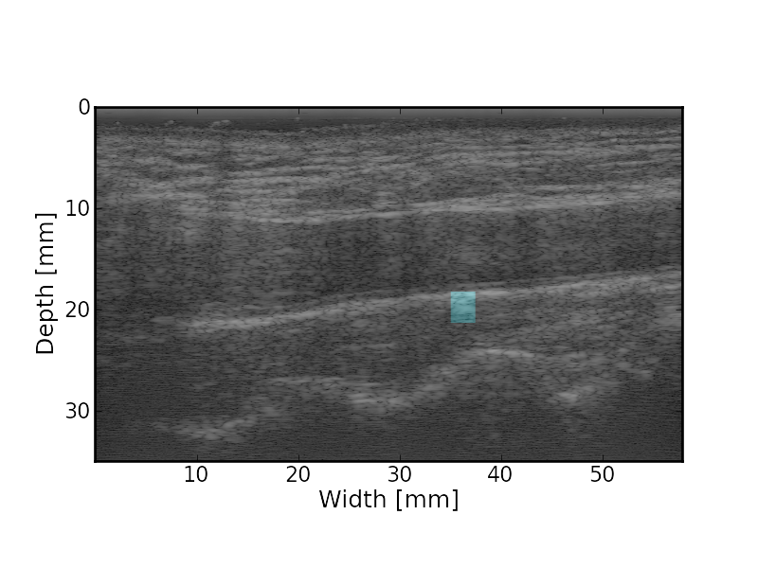
Strain imaging algorithm Block-matching motion tracking
Matching
Kernel
Fixed
image
Displacement Images
Moving
image
Search
Region
Strain Images
Cardiac Cycle Accumulation
Strain Metrics
Notes:
23

Slide 24
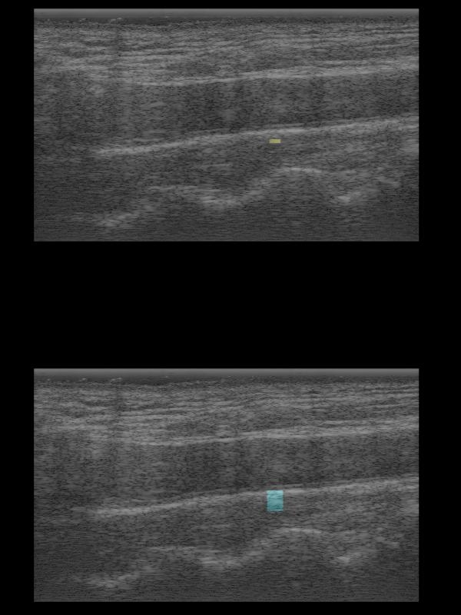
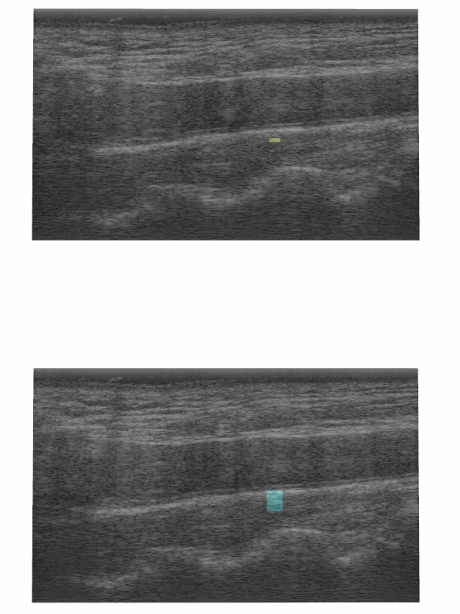
Strain imaging algorithm Block-matching motion tracking
Matching
Kernel
Displacement Images
Search
Region
Strain Images
Cardiac Cycle Accumulation
Strain Metrics
Notes:
24

Slide 25
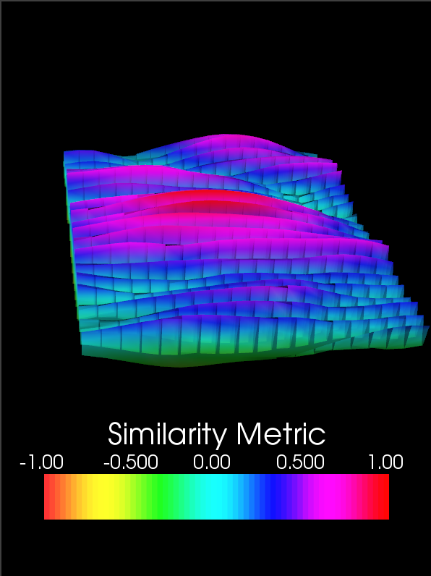
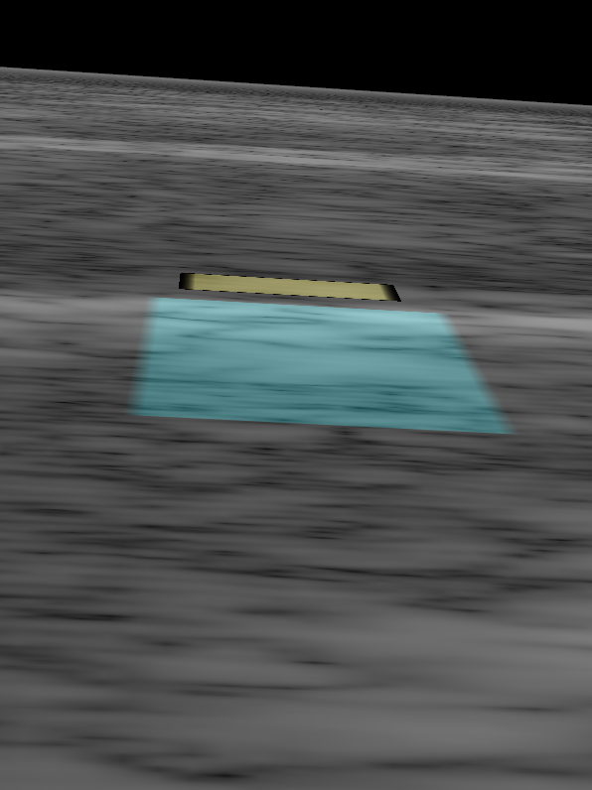
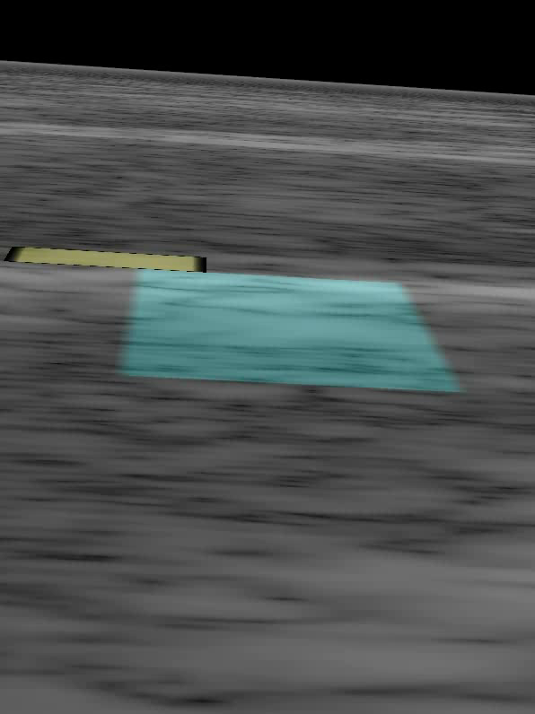
Strain imaging algorithm Block-matching motion tracking
Displacement Images
Strain Images
Cardiac Cycle Accumulation
Strain Metrics
Notes:
25

Slide 26
Strain imaging algorithm Block-matching motion tracking
Displacement Images
Strain Images
Cardiac Cycle Accumulation
Strain Metrics
Notes:
26

Slide 27
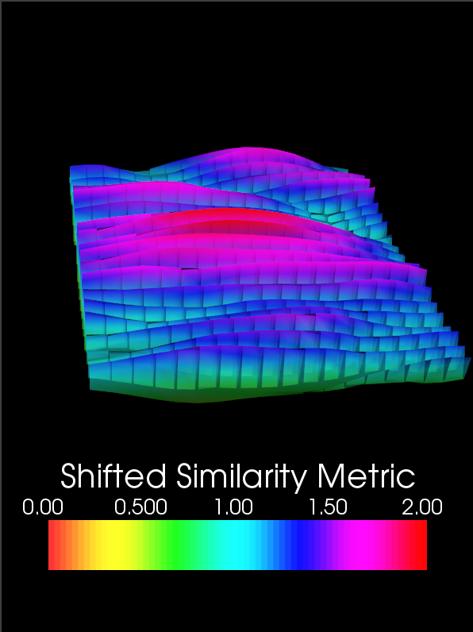
Strain imaging algorithm Noise resistance with Bayesian regularization
Shift by theoretical lower bound
Displacement Images
Strain Images
Cardiac Cycle Accumulation
Strain Metrics
Notes:
27

Slide 28
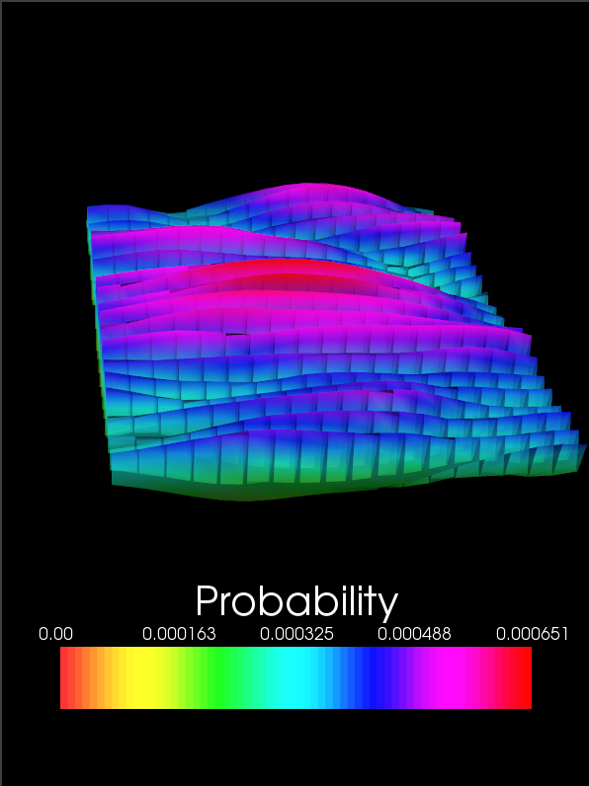
Strain imaging algorithm Noise resistance with Bayesian regularization
Shift by theoretical lower bound
Normalize such that the values sum to one
Displacement Images
Strain Images
Cardiac Cycle Accumulation
Strain Metrics
Notes:
28

Slide 29



Strain imaging algorithm Noise resistance with Bayesian regularization
Recursive Bayesian Regularization¹
Displacement Images
Strain Images
Cardiac Cycle Accumulation
¹McCormick, M. Rubert, N., and Varghese, T. Bayesian Regularization Applied to Ultrasound Strain Imaging. IEEE Transactions in Biomedical Engineering. 2011. In Press.
Strain Metrics
Notes:
29

Slide 30

Strain imaging algorithm Noise resistance with Bayesian regularization
Recursive Bayesian Regularization¹
Displacement Images
Strain Images
Cardiac Cycle Accumulation
¹McCormick, M. Rubert, N., and Varghese, T. Bayesian Regularization Applied to Ultrasound Strain Imaging. IEEE Transactions in Biomedical Engineering. 2011. In Press.
Strain Metrics
Notes:
30

Slide 31
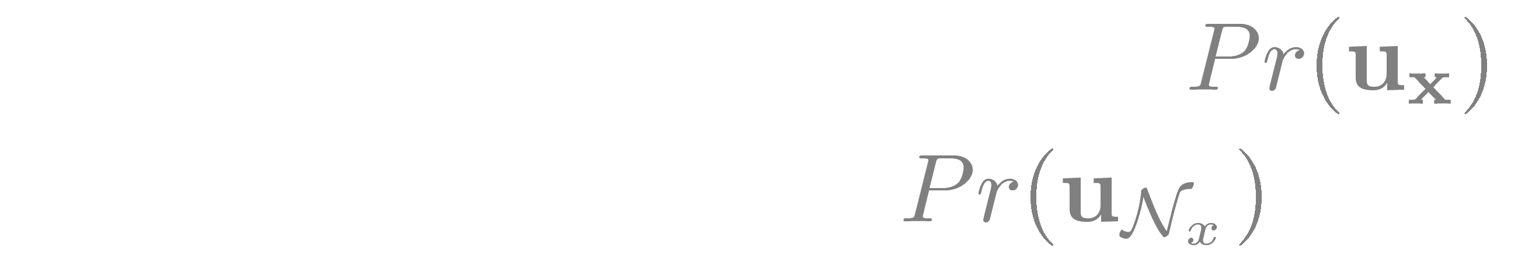
Strain imaging algorithm Noise resistance with Bayesian regularization
Recursive Bayesian Regularization¹
Displacement Images
Strain Images
Cardiac Cycle Accumulation
¹McCormick, M. Rubert, N., and Varghese, T. Bayesian Regularization Applied to Ultrasound Strain Imaging. IEEE Transactions in Biomedical Engineering. 2011. In Press.
Strain Metrics
Notes:
31

Slide 32
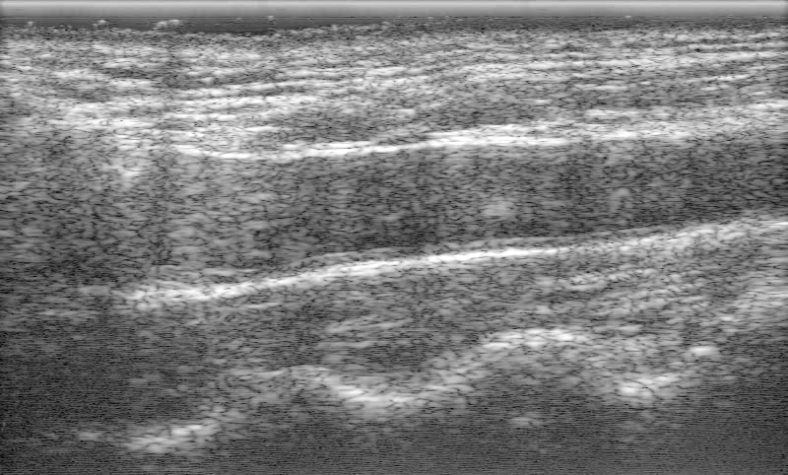
Strain imaging algorithm Bayesian regularization example: Removal of a reverberation
Displacement Images
Strain Images
Carotid artery
Cardiac Cycle Accumulation
Strain Metrics
Notes:
32

Slide 33
Strain imaging algorithm Bayesian regularization example: Removal of a reverberation
Displacement Images
Strain Images
Search Region
Cardiac Cycle Accumulation
Strain Metrics
Notes:
33

Slide 34
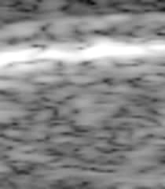
Strain imaging algorithm Bayesian regularization example: Removal of a reverberation
Displacement Images
Strain Images
Reverberation moving in the opposite direction of surrounding tissue
Cardiac Cycle Accumulation
Strain Metrics
Notes:
34

Slide 35
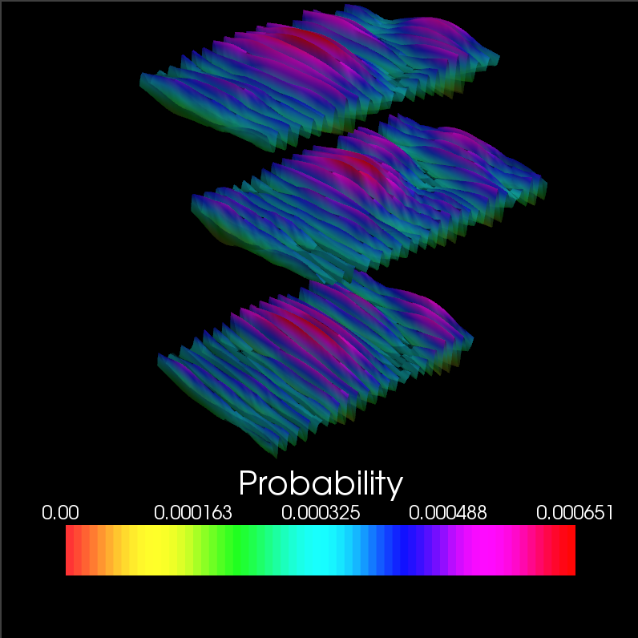
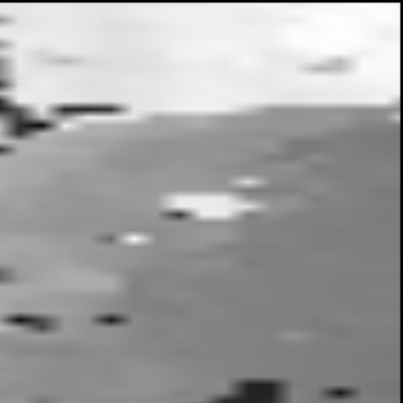
Strain imaging algorithm Bayesian regularization example: Removal of a reverberation
Regularization iteration 0
Block of interest
Lateral neighbor
Axial neighbor
Axial Displacement
Displacement Images
Strain Images
Cardiac Cycle Accumulation
B-Mode
Strain Metrics
Notes:
35

Slide 36
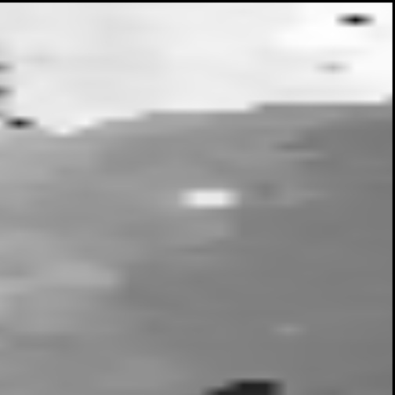
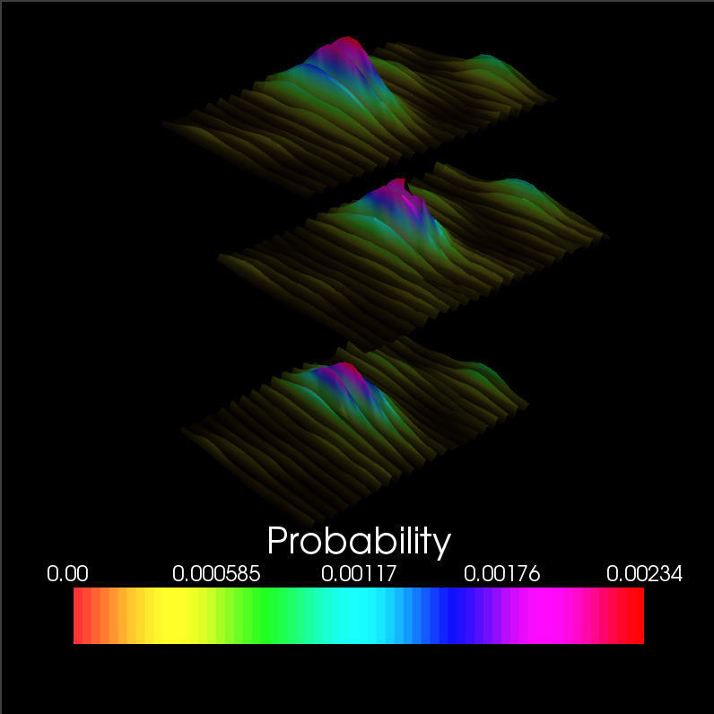
Strain imaging algorithm Bayesian regularization example: Removal of a reverberation
Regularization iteration 1
Block of interest
Lateral neighbor
Axial neighbor
Axial Displacement
Displacement Images
Strain Images
Cardiac Cycle Accumulation
B-Mode
Strain Metrics
Notes:
36

Slide 37
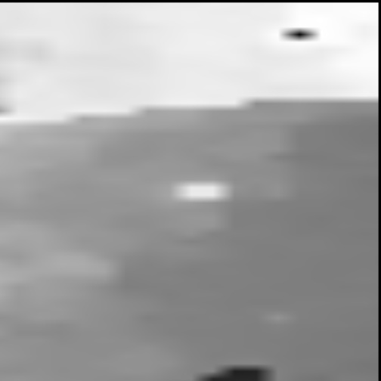
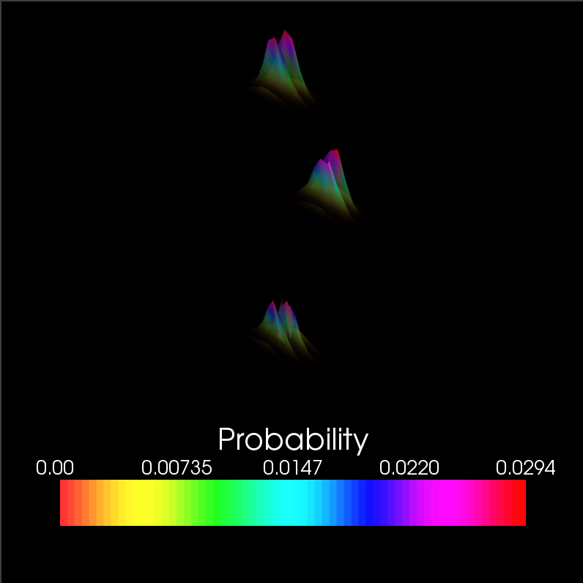
Strain imaging algorithm Bayesian regularization example: Removal of a reverberation
Regularization iteration 2
Block of interest
Lateral neighbor
Axial neighbor
Axial Displacement
Displacement Images
Strain Images
Cardiac Cycle Accumulation
B-Mode
Strain Metrics
Notes:
37

Slide 38
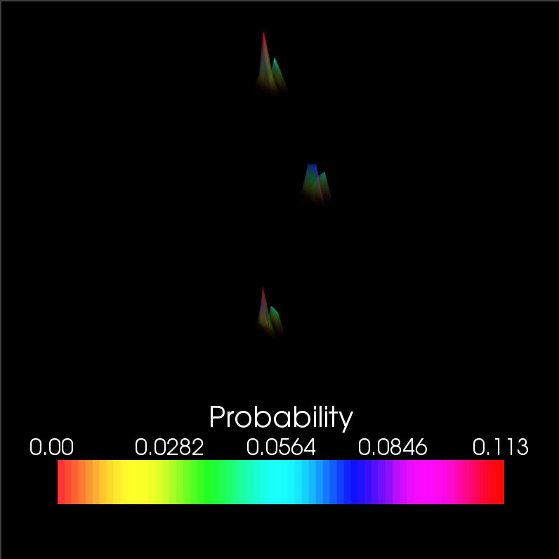
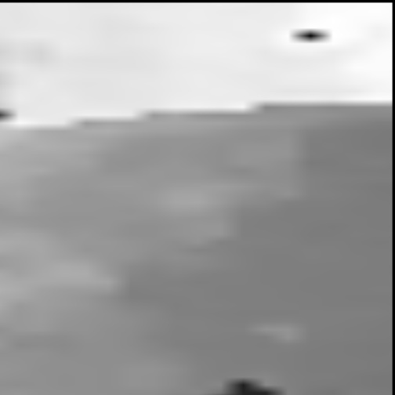
Strain imaging algorithm Bayesian regularization example: Removal of a reverberation
Regularization iteration 3
Block of interest
Lateral neighbor
Axial neighbor
Axial Displacement
Displacement Images
Strain Images
Cardiac Cycle Accumulation
B-Mode
Strain Metrics
Notes:
38

Slide 39
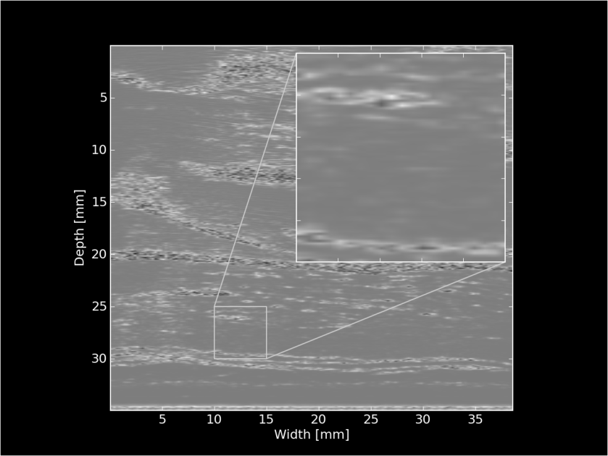
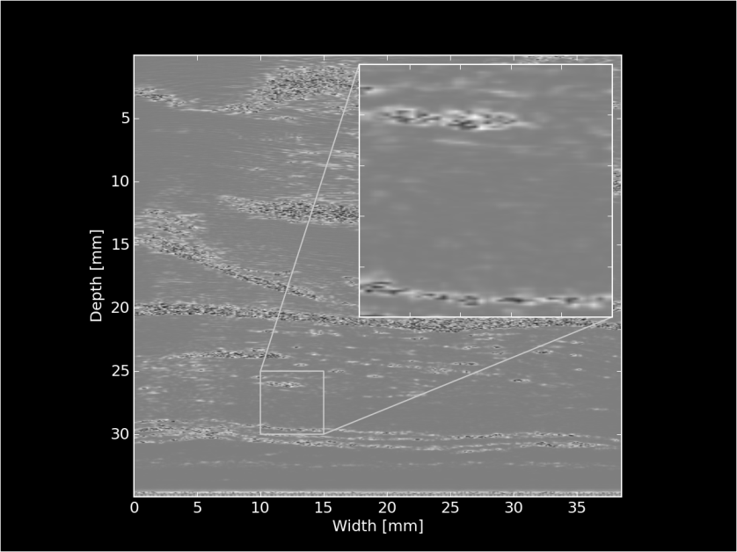
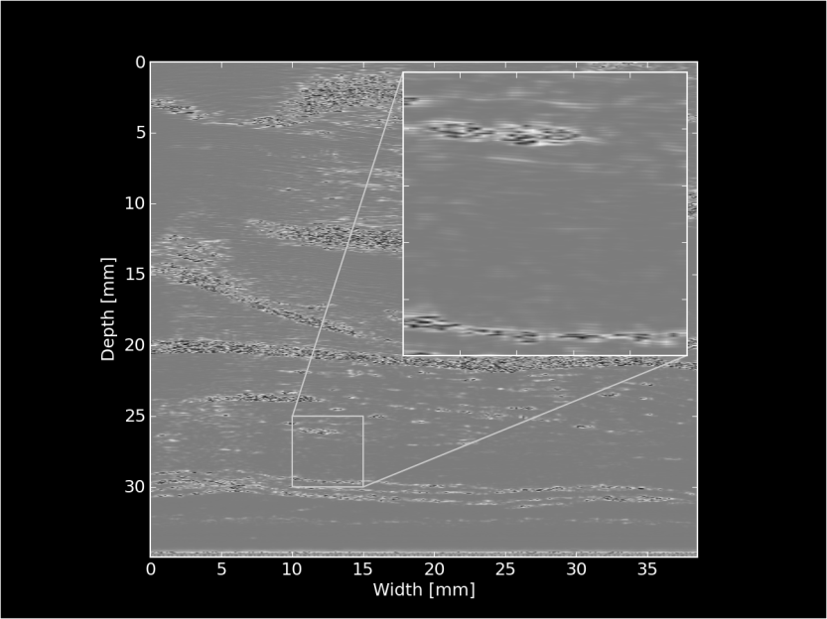
Strain imaging algorithm Multi-level motion tracking
Displacements
initialize search
Displacements
initialize search
156×605 pixels
312×908 pixels
312×1816 pixels
Displacement Images
Strain Images
Cardiac Cycle Accumulation
Strain Metrics
Notes:
39

Slide 40
Strain imaging algorithm Multi-level motion tracking
Displacements
initialize search
Displacements
initialize search
156×605 pixels
312×908 pixels
312×1816 pixels
Displacement Images
Strain Images
Displacement subsample
interpolation
Strain images?
Cardiac Cycle Accumulation
Strain Metrics
Notes:
40

Slide 41
Strain imaging algorithm Subsample interpolation
Objective: interpolate the similarity metric function to find subsample displacement of the matching block
Displacement Images
Strain Images
Cardiac Cycle Accumulation
Strain Metrics
Notes:
41

Slide 42
Strain imaging algorithm Subsample interpolation
Methods:
Parabolic interpolation
Fit a parabola to three point surrounding maximum sample
2D windowed-sinc interpolation with numerical optimization¹
Iteratively locate the subsample peak with unbiased interpolation
Displacement Images
Strain Images
Cardiac Cycle Accumulation
Strain Metrics
Notes:
42

Slide 43
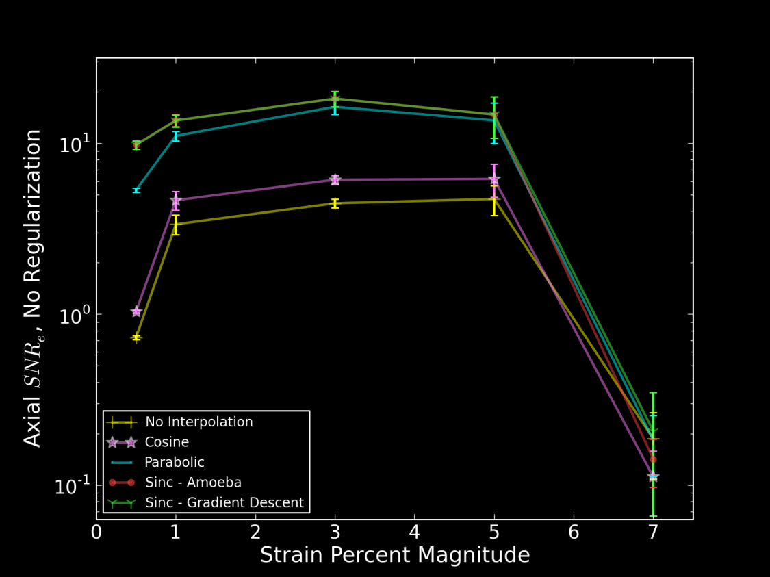
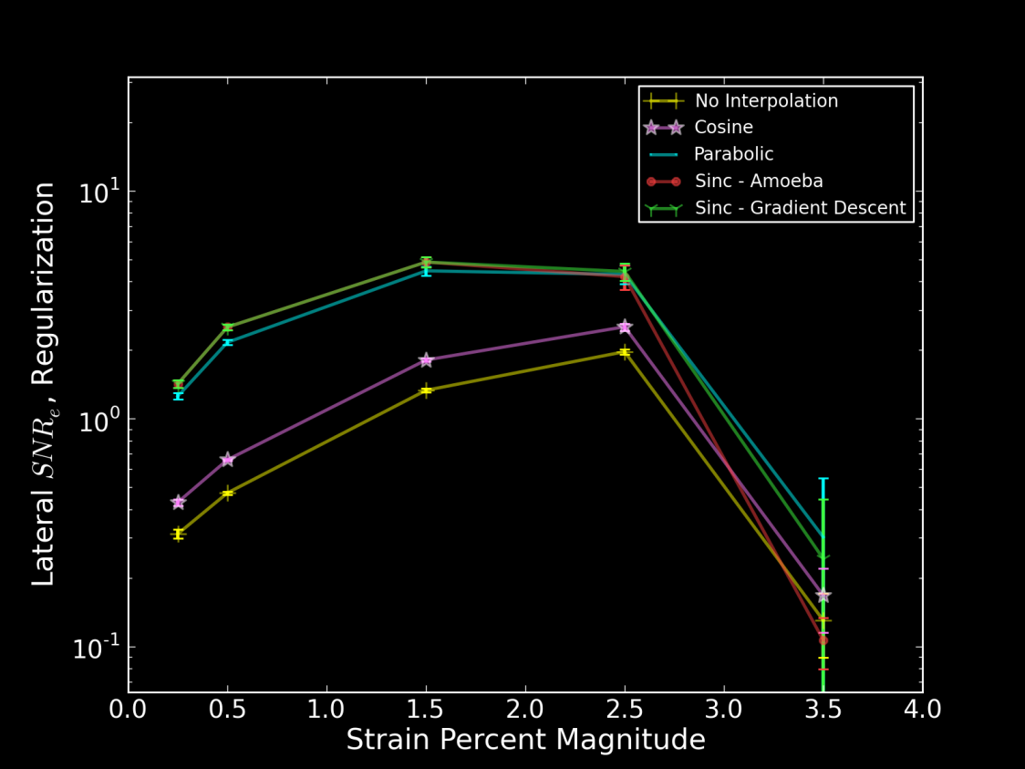
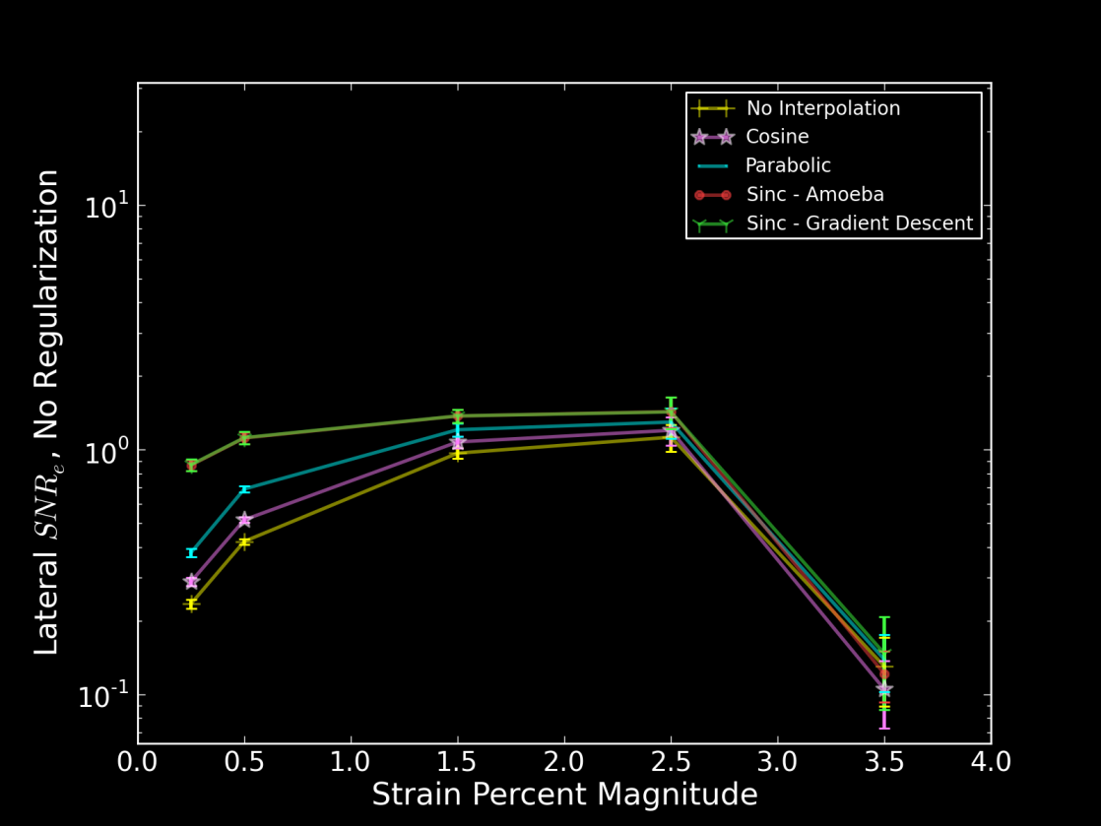
Strain imaging algorithm Subsample interpolation
Displacement Images
Strain Images
Cardiac Cycle Accumulation
Strain Metrics
Notes:
43

Slide 44
Strain imaging algorithm Strain: quantification of tissues’ mechanical distortion
Displacement Images
Strain Images
Cardiac Cycle Accumulation
Strain Metrics
Notes:
44

Slide 45
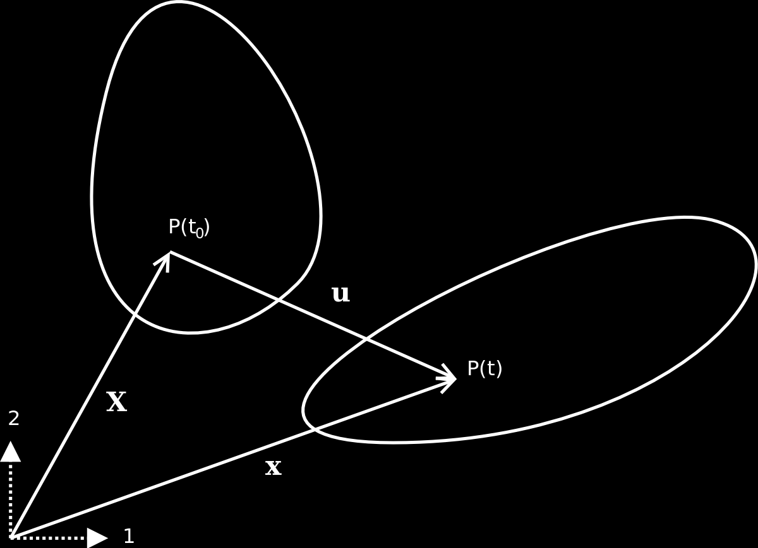
Strain imaging algorithm Strain: quantification of tissues’ mechanical distortion
Pre-deformation body
Post-deformation body
Displacement Images
Strain Images
Cardiac Cycle Accumulation
Strain Metrics
Notes:
45

Slide 46
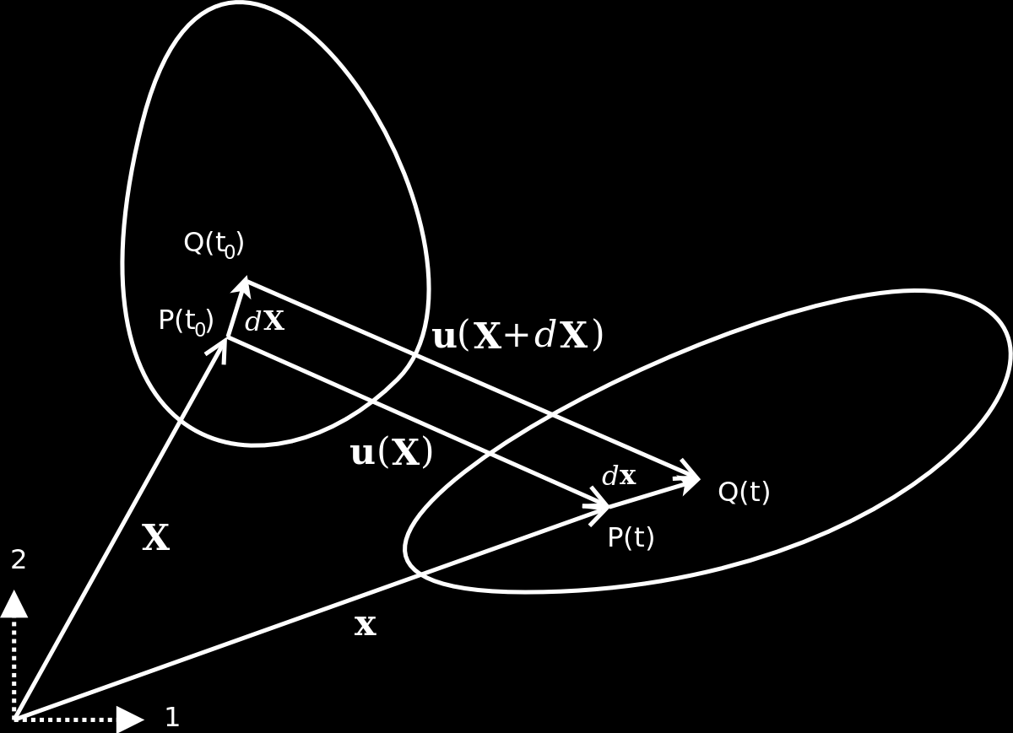
Strain imaging algorithm Strain: quantification of tissues’ mechanical distortion
Pre-deformation body
Post-deformation body
Displacement Images
Strain Images
Cardiac Cycle Accumulation
Strain Metrics
Notes:
46

Slide 47

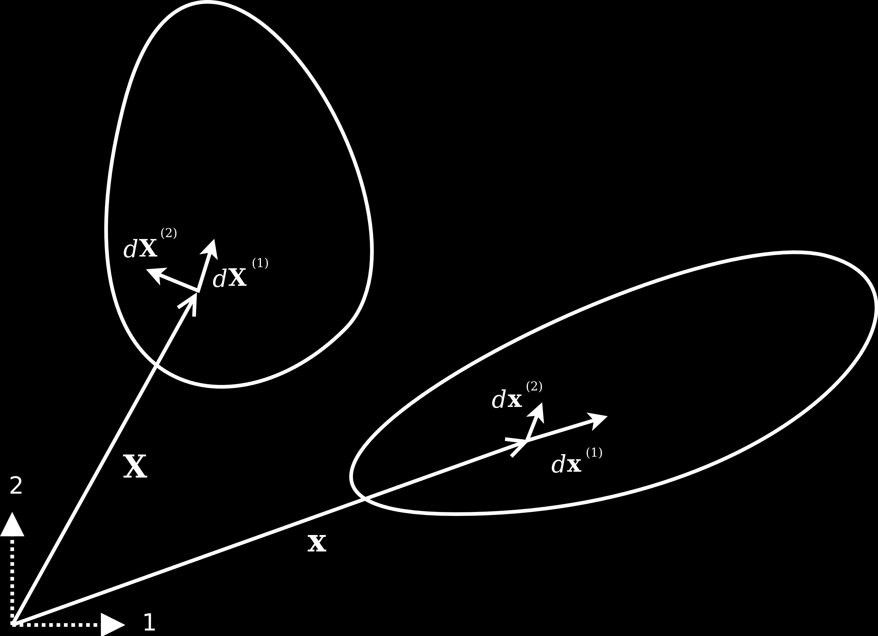



Strain imaging algorithm Strain: quantification of tissues’ mechanical distortion
Pre-deformation body
Green-Lagrangian strain:
Post-deformation body
Displacement Images
Strain Images
Eulerian-Almansi strain:
Cardiac Cycle Accumulation
Strain Metrics
Notes:
47

Slide 48
Strain imaging algorithm Physical interpretation of strain
Equation Implications
Interpretation:
Change in length, change in angle of differential segments
Displacement Images
Strain Images
Cardiac Cycle Accumulation
Strain Metrics
Notes:
48

Slide 49


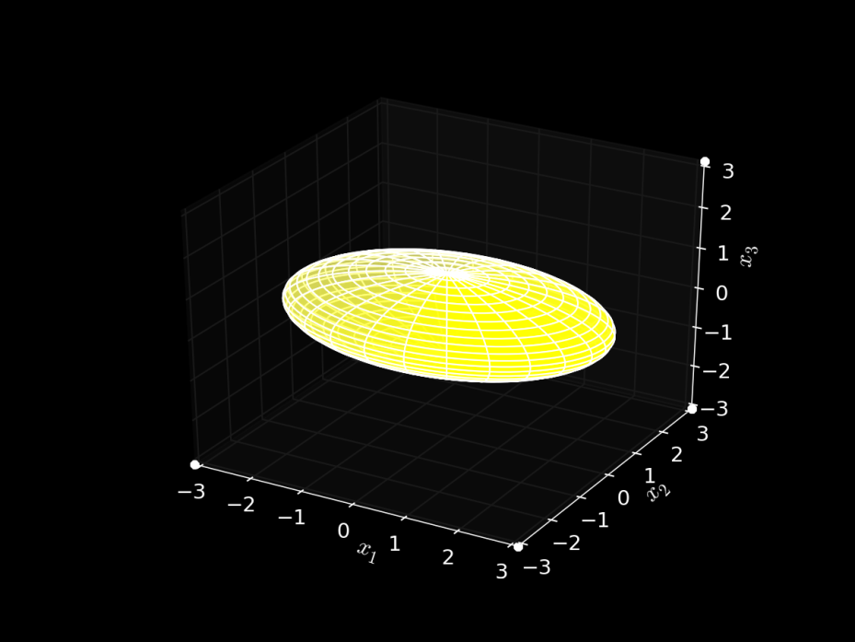
Strain imaging algorithm Ellipse representation of strain
Equation Implications
Diffusion Tensor MRI
Interpretation:
Change in length, change in angle of differential segments
Ellipse representation
Ellipsoid
Displacement Images
Strain Images
Cardiac Cycle Accumulation
Strain Metrics
Notes:
49

Slide 50
Strain imaging algorithm Ellipse representation of strain
Equation Implications
Diffusion Tensor MRI
Interpretation:
Change in length, change in angle of differential segments
Ellipse representation
Same quadric form
Real, symmetric: has Eigenvalues
Displacement Images
Strain Images
Cardiac Cycle Accumulation
Strain Metrics
Notes:
50

Slide 51






Strain imaging algorithm Ellipse representation of strain
Equation Implications
Interpretation:
Change in length, change in angle of differential segments
Ellipse representation
Displacement Images
Strain Images
Cardiac Cycle Accumulation
Strain tensor ellipses
Strain Metrics
Individual strain tensor components
Notes:
51

Slide 52



Strain imaging algorithm Strain over cardiac cycle
Pre-deformation body
Post-deformation body
Displacement Images
Strain Images
Cardiac Cycle Accumulation
Strain Metrics
Notes:
52

Slide 53
Strain imaging algorithm Accumulating strain over the cardiac cycle
The problem: tissue to accumulate over is moving
Displacements are generally not pixel multiples
The solution: accumulate on particles
Displacement Images
Strain Images
Cardiac Cycle Accumulation
Strain Metrics
Notes:
53

Slide 54




Strain imaging algorithm Accumulating strain over the cardiac cycle
B-Mode
Binary mask segmentation
Mesh segmentation
Displacement Images
Strain Images
Cardiac Cycle Accumulation
Strain Metrics
Notes:
54

Slide 55

Strain imaging algorithm Accumulating strain over the cardiac cycle
Displacement Images
Strain Images
Cardiac Cycle Accumulation
Strain Metrics
Notes:
55

Slide 56




Strain imaging algorithm Tensor to scalar: yield criteria
Maximum principal strain
Maximum shear strain
Total strain energy
Displacement Images
Strain Images
Distortional energy
Cardiac Cycle Accumulation
Strain Metrics
Notes:
56

Slide 57
Non-invasive in vivo strain imaging Imaging plaque mechanics
Notes:
57

Slide 58
Non-invasive in vivo strain imaging Influence of morphology
Displacement vectors
Notes:
58

Slide 59



Non-invasive in vivo strain imaging Influence of morphology
Notes:
59

Slide 60

Non-invasive in vivo strain imaging Influence of morphology
Strain tensor ellipse
Notes:
60

Slide 61
Factors that increase risk
Increased hemodynamic forces
Hypertension
Cyclic loading
Stress concentrators
Material inhomogeneity
Morphological irregularity
Ulceration
Vasa vasorum
Weak materials
Inflammation and enzymes such as matrix metalloproteinase-9.
Weak constituents such as lipid or fresh hemorrhage.

Slide 62




Non-invasive in vivo strain imaging Influence of morphology
Notes:
62

Slide 63
Acknowledgements
Committee members
- Dr. Robert Dempsey
- Dr. Timothy Hall
- Dr. Mark Kliewer
- Dr. Elizabeth Meyerand
- Dr. Tom Yin
- Dr. Tomy Varghese
- Dr. James Zagzebski
Phantom Experts
- Dr. Ernest Madsen
- Gary Frank
- Meagan Deaner
Ultrasonographers
- Dr. Carol Mitchell
- Sara Baker
- Bridgett Finnegan
Visualsonics
- Dr. Tim Hacker
- Dr. Tim Stiles
Research coordination
- Pam Winne
- Cindy Colombo
- Niki Virnig
Pathology
- Dr. Shahriar Salamat
Condor
- Dr. Orhan Unal
- Xiaohu Mo
- Dr. Michael Kissick
- Bill Taylor
- Yacouba Traore
UW-THW
- Dr. Nicholas Preston
- Dr. Paul Wilson
- Dr. Milad Fatenejad
- Dr. Matthew Terry
- Anthony Scopatz
- Katy Huff
- Rachel Slaybough
- Aronne Merrelli
- Royal Elmore
…
Dept. Administrators
- JoAnn Kronberg
- Beth Bierman
- Anne Duchek
Ultrasound group members
- Dr. Hairong Shi
- Dr. Maritza Hobson
- Dr. Jingfeng Jiang
- Dr. Miklos Kiss
- Dr. Ted Fisher
- Dr. Dave Duncan
- Xiao Wang
- Kibo Nam
- Ryan DeWall
- Nick Rubert
- Matthew Bayer
- Haiyan Xu
- Eenas Omari
- Lisa Reusch
- Chi Ma
- Wenqi Ge
- Kayvan Samimi
- Eric Nordberg
- Dr. Jihad Al-Sadah
- Ivan Rosado-Mendez
- Lindsey Carlson
- Janelle Anderson
- Theo Pavan
- Heichang Lee
Medical Physics Graduate Students, Faculty, and Scientists
Roommates
- Michael Tomkowiak
- Matthew Nyflot
- Armando Ibarra
Family
- Parents, Dr. Michael and Bernadette McCormick
- Siblings, Erin, Paul, Ryan, Rebecca, Sean
- Uncle, Patrick and Sara McCormick, and cousins
5-Hour Energy

Slide 64

Transcranial Doppler Anatomy
Wish to validate the presence of microemboli in vivo to associate with plaque risk.
Cannot be detected in carotid ultrasound because of resolution and coverage issues.
Transcranial Doppler monitoring of middle cerebral artery.

Slide 65


Transcranial Doppler HITS
Microemboli indicated by high intensity transient signal (HITS)
Lasts < 300 ms
Intensity at least 3dB higher than background
Unidirectional in velocity
Unilateral
Audible ‘snap’, ‘chirp’, or ‘moan’

Slide 66


Transcranial Doppler Data review
Velocity
Time

Slide 67



Where have we come from? Guy Cloutier’s October 2010 assessment
Snowbird 2006
Snowbird 2010

Slide 68



Where have we come from? Guy Cloutier’s October 2010 assessment
Unsolved problems?
1. Investigate operator dependence
2. Increase algorithm robustness
3. New criteria of vulnerability

Slide 69

Where are we going? Future work
Process available patient data
Improve high-frequency data utilization and image quality
Improved attenuation estimation
Segment and register with histology
New TCD machine

Slide 70
Publications
Peer reviewed articles
McCormick, M and Varghese, T. An Approach to Unbiased Subsample Interpolation
For Motion Tracking. Ultrasonics. In Review. 2011.
McCormick, M, Madsen, E, Deaner, M, Varghese, T. Absolute Backscatter Coefficient Estimation of Tissue-Mimicking Phantoms in eth 5-50 MHz Frequency Range. Journal of the Acoustical Society of America. In Review. 2011.
McCormick, M, Rubert, N, and Varghese, T. Bayesian Regularization Applied to Ultrasound Strain Imaging. IEEE Transactions on Biomedical Engineering. In Press 2011.
Madsen, E, Frank, G, McCormick, M, and Deaner, M. Anechoic Sphere Phantoms for Estimating 3-D Resolution of Very High Frequency Ultrasound Scanners. IEEE Transactions on Ultrasonics, Ferroelectrics, and Frequency Control. 57 (10):2284-2292. 2010.
Shi, H, Varghese, T, Mitchell, C, McCormick, M, Dempsey, RJ, Kliewer, MA. In-vivo Attenuation and Equivalent Scatter Size Parameters for Atherosclerotic Carotid Plaque: Preliminary Results. Ultrasonics 49 (8):779-785. 2009.
Shi, H, Mitchell, CC, McCormick, M, Kliewer, MA, Dempsey, RJ, Varghese, T. Preliminary In Vivo Atherosclerotic Carotid Plaque Characterization Using the Accumulated Axial Strain and Relative Lateral Shift Indices. Phys Med Biol. 53 (22):6377-97. 2008.

Slide 71
Publications
Conference Abstracts
McCormick, M and Varghese, T. Reduction of Reverberation Artifacts in Carotid Strain Images Using Bayesian Regularization. International Conference on the Ultrasonic Measurement and Imaging of Tissue Elasticity. Oct 16, 2010. Snowbird, Utab.
McCormick, M and Varghese, T. Subsample Displacement Interpolation Using Windowed-Sinc Reconstruction with Numerical Optimization. International Conference on the Ultrasonic Measurement and Imaging of Tissue Elasticity. Oct 16, 2010. Snowbird, Utab.
McCormick, M and Varghese, T. Open Technologies Applied to a Non-standard Medical Image Format for Innovative Research. MathBio2: IMAGE. November 2009. Madison, WI.
McCormick, M, Varghese, T, Dempsey, RJ, Zagzebski, J, and Madsen, E. High Frequency Ultrasonic Characterization of Excised Atherosclerotic Carotid Plaque. Ultrasonic Imaging and Tissue Characterization Symposium. June 2009. Arlington, VA.
Madsen, E, McCormick, M, Frank, G. Phantoms for Assessing Intravascular (IVUS) Ultrasound Scanners. American Institudes in Ultrasound and Medicine Conference. April 2009. New York, NY.
McCormick, M, Shi, H, Mitchell, C, Kliewer, M, Dempsey, R, Varghese, T. Mechanical Viscoelastic Variations of In Vivo Carotid Atheromas using External Ultrasound. International Conference on the Ultrasonic Measurement and Imaging of Tissue Elasticity. Oct 8, 2006. Snowbird, Utah, USA.

Slide 72
Related Pathologies: Different intensities and time courses
Transient ischemic attacks (TIA) are cerebral impairment that subside in under 24 hours, which often precede a stroke.
Recent evidence has correlated microemboli that may cause chronic ischemic burden with dementia in Alzheimer’s.
A correlation has also been observed between migraine and ischemic stroke.

Slide 73
The Problem: Stroke
Stroke is the loss of brain function due to hypoxia.
Effects of a stroke include impaired movement, impaired speech, impaired cognition, or death.
Very prevalent, in the United States¹:
Leading cause of serious, long-term disability.
780,000 new cases in 2005.
Third leading cause of death.
150,000 deaths in 2004.
$43.7 billion dollars in direct medical costs in 2008.
¹American Heart Association. Heart disease and stroke statistics – 2008 update. Online.

Slide 74
Current methods for assessing Risk
Currently, stenosis >70% qualifies a patient for endarterectomy.
With this assessment method, only 16% of patients that have a carotid endarterectomy benefit from surgery¹.
¹P.M. Rothwell and C.P Warlow. Prediction of benefit from carotid endarterectomy in individual patients: a risk-modeling study. European Carotid Surgery Trials’ collaborative group. Lancet, 353 (9170): 2105-2110, Jun 1999.

Slide 75
Proposed method for assessing Risk
Directly measures how close tissue is to failure/ rupture.
High hemodynamic forces and intense stress concentrators result in high strains.
Lipid and hemorrhage, weaker materials, also have low elastic moduli and will have high strains.
Figure taken from G.A. Holzapel, G. Sommer, and P. Regitnig. Anisotropic mechanical properties of tissue components in human atherosclerotic plaques. Journal of Biomechanical Engineering – Transactions of the ASME. 126(5):657-665, 2004.
Notes:
75

Slide 76
Methods being investigated to assess Risk
Image plaque composition.
Ultrasound
MRI
Image markers of inflammation.
PET
Catheter based methods
Image ulceration or vasa vasorum.
Angiography
Ultrasound
MRI

Slide 77

Non-invasive in vivo strain imaging Influence of composition
Notes:
77

Slide 78

High frequency US characterization Visualsonics user interface

Slide 79
High frequency US characterization Requirements
There have been previous efforts to create integrated backscatter images, but all used the planar reflector method.
We propose the use of the reference phantom method, but it requires a stable, well characterized reference phantom with acoustic properties similar to plaque.
We have to quantify
Attenuation
Alignment, play, small spaces
Signal attenuation and sampling rate
Water attenuation and Saran transmission coefficient
Absolute backscatter coefficient
Attenuation and alignment
Measure transducer effective aperture and focus

Slide 80
High frequency US characterization Integrated backscatter coefficient
Create images of the integrated backscatter coefficient.
The backscatter coefficient is backscattered power per solid angle per volume per incident intensity of a plane wave
Varies with frequency Integrate
Quantity that reflects material properties
Effective scatterer size
Acoustic impedance gradient
Scatterer density
Notes:
80

Slide 81



Strain imaging algorithm Displacement gradient calculation for noisy, discontinuous data
Equation Implications
Interpretation:
Change in length, change in angle of differential segments
Ellipse representation
Calculation:
Displacement gradients
Noisy
Local least-squares linear fit to estimate displacement gradients
Displacement Images
Strain Images
Cardiac Cycle Accumulation
Strain Metrics
Notes:
81

Slide 82




Strain imaging algorithm Displacement gradient calculation for noisy, discontinuous data
Equation Implications
Interpretation:
Change in length, change in angle of differential segments
Ellipse representation
Calculation:
Displacement gradients
Noisy
B-Mode
Axial displacement
Displacement Images
Strain Images
Cardiac Cycle Accumulation
Axial strain
Discontinuity corrected strain
Displacement along line
Strain Metrics
Notes:
82

Slide 83
Non-invasive in vivo strain imaging Influence of hemodynamics
Notes:
83

Slide 84
Factors that increase risk
Increased hemodynamic forces
Hypertension
Cyclic loading
Stress concentrators
Material inhomogeneity
Morphological irregularity
Ulceration
Vasa vasorum
Weak materials
Inflammation and enzymes such as matrix metalloproteinase-9.
Weak constituents such as lipid or fresh hemorrhage.

Slide 85

Non-invasive in vivo strain imaging Influence of hemodynamics
Strain tensor ellipse
Notes:
85

Slide 86

Non-invasive in vivo strain imaging Influence of hemodynamics
Notes:
86

Slide 87


Non-invasive in vivo strain imaging Influence of composition
Notes:
87

Slide 88
Factors that increase risk
Increased hemodynamic forces
Hypertension
Cyclic loading
Stress concentrators
Material inhomogeneity
Morphological irregularity
Ulceration
Vasa vasorum
Weak materials
Inflammation and enzymes such as matrix metalloproteinase-9.
Weak constituents such as lipid or fresh hemorrhage.

Slide 89

Non-invasive in vivo strain imaging Influence of composition
Displacement vectors
Notes:
89

Slide 90

Non-invasive in vivo strain imaging Influence of composition
Strain tensor ellipse
Notes:
90

Slide 91

Non-invasive in vivo strain imaging Influence of composition
Notes:
91

Slide 92


Non-invasive in vivo strain imaging High wall shear
Displacement vectors
Notes:
92

Slide 93
Factors that increase risk
Increased hemodynamic forces
Hypertension
Cyclic loading
Stress concentrators
Material inhomogeneity
Morphological irregularity
Ulceration
Vasa vasorum
Weak materials
Inflammation and enzymes such as matrix metalloproteinase-9.
Weak constituents such as lipid or fresh hemorrhage.

Slide 94


Non-invasive in vivo strain imaging High wall shear
Strain tensors
Notes:
94

Slide 95


Non-invasive in vivo strain imaging High wall shear
Notes:
95

Slide 96

Non-invasive in vivo strain imaging Complex plaque with calcification
Displacement vectors
Notes:
96

Slide 97
Factors that increase risk
Increased hemodynamic forces
Hypertension
Cyclic loading
Stress concentrators
Material inhomogeneity
Morphological irregularity
Ulceration
Vasa vasorum
Weak materials
Inflammation and enzymes such as matrix metalloproteinase-9.
Weak constituents such as lipid or fresh hemorrhage.

Slide 98

Non-invasive in vivo strain imaging Complex plaque with calcification
Strain tensor ellipses
Notes:
98

Slide 99

Non-invasive in vivo strain imaging Complex plaque with calcification
Notes:
99

Slide 100
High frequency US characterization Overview
High frequency = high resolution
3D
Quantitative ultrasound imaging
Remove system effects
Use reference phantom with known acoustic properties to normalize out imaging system properties
Notes:
100

Slide 101

High frequency US characterization Reference phantom characterization
¹Madsen, E., Frank, G. McCormick, M. Deaner, M. Anechoic Sphere Phantoms for Estimating 3-D Resolution of Very High Frequeuncy Ultrasound Scanners. IEEE Transactions on Ultrasonics, Ferroelectrics, and Frequency Control. 57 (10):2284-2292. 2010.
Notes:
101

Slide 102


High frequency US characterization Reference phantom characterization
High frequency challenges
High signal attenuation
Increased precision required
Non-linear propagation
Notes:
102

Slide 103

High frequency US characterization Speed of sound
Notes:
103

Slide 104

High frequency US characterization Attenuation
Notes:
104

Slide 105

High frequency US characterization Absolute backscatter coefficient
¹McCormick, M., Madsen, E., Deaner, M., and Varghese, T. Absolute Backscatter Coefficient Estimates of Tissue-Mimicking Phantoms in the 5-50MHz Frequency Range. Journal of The Acoustical Society of America. Under Review.
Notes:
105

Slide 106

High frequency US characterization Plaque characterization
Notes:
106

Slide 107

High frequency US characterization High risk plaque
Large plaque with excessive amount of thrombus and signs of inflammation on removal.
Ulcerated, complex morphology of the inner wall with soft, weak plaque and little calcification.
Likely unstable with recent rupture events.

Slide 108

High frequency US characterization Plaque characterization
Notes:
108

Slide 109

High frequency US characterization Plaque characterization
Notes:
109

Slide 110
High frequency US characterization Plaque characterization
Notes:
110

Slide 111


High frequency US characterization Low risk plaque
Long plaque composed primarily of fibrous tissue with dispersed calcified areas.
Smooth, regular inner wall.
Likely stable.

Slide 112

High frequency US characterization Plaque characterization
Notes:
112

Slide 113

High frequency US characterization Plaque characterization
Notes:
113

Slide 114

Strain imaging algorithm Multi-level motion tracking
Why?
Robustness
Avoid local minima (“peak-hopping”) in the similarity metric
Speed
Smaller search regions in higher resolution images
Stretch matching-block by prior strain results
Improve correlation
Displacement Images
Strain Images
Cardiac Cycle Accumulation
Strain Metrics
Notes:
114

Slide 115


Strain imaging algorithm Accumulating strain over the cardiac cycle
Pre-deformation
Post-deformation
Displacement Images
Strain Images
Cardiac Cycle Accumulation
Strain Metrics
Notes:
115

Slide 116


Strain imaging algorithm Accumulation of incremental Eulerian strain: particle approach
Calculate incremental displacements
Use dynamic frame skip
Right amount of motion for best motion-tracking
Accumulate incremental Eulerian strains
Diastole
Systole
Displacement Images
Strain Images
Cardiac Cycle Accumulation
Strain Metrics
Notes:
116

Slide 117
Strain imaging algorithm Scalar over cardiac cycle to single value
Peak-to-peak mean
Peak-to-peak 90th percentile
Peak-to-peak variance
All three of the above for the sum of the magnitude of the time derivative
Displacement Images
Strain Images
Cardiac Cycle Accumulation
Strain Metrics
Notes:
117

